Slide 1


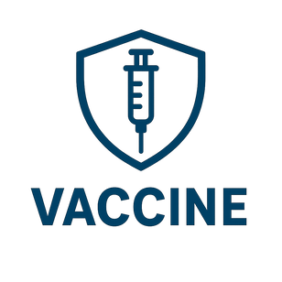
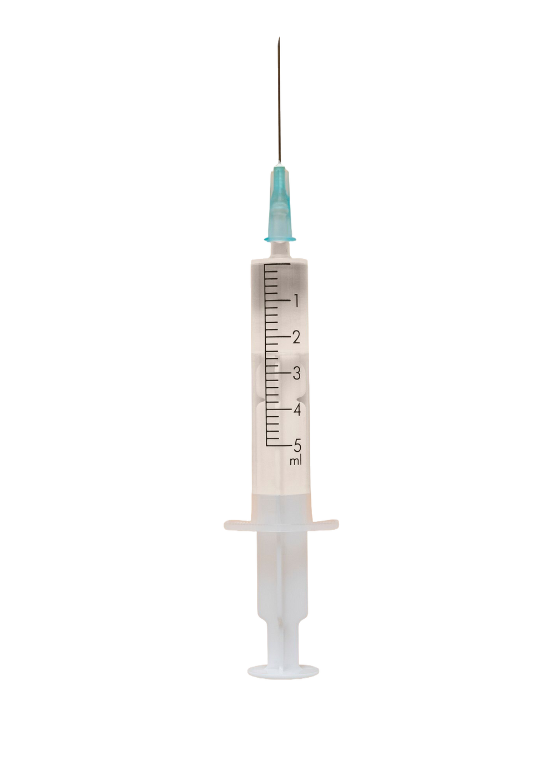


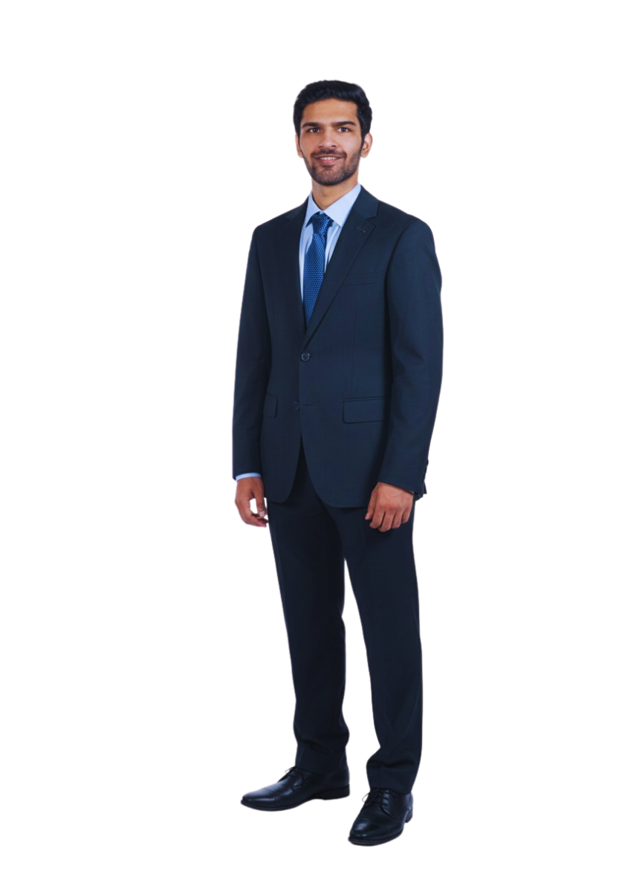
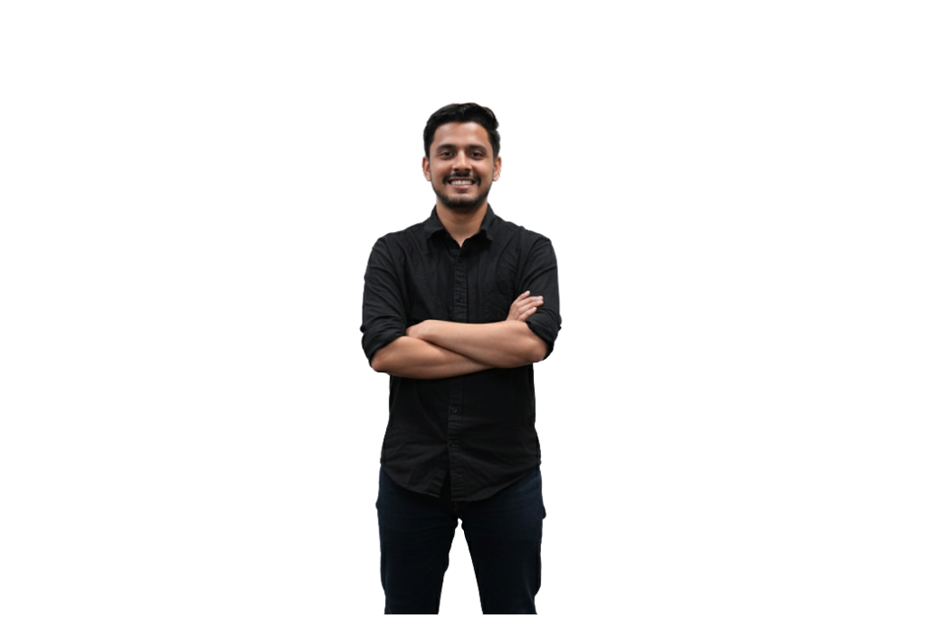


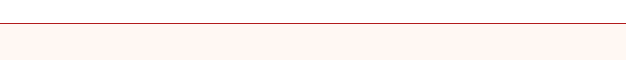
VaccineCo
CORNELL EMI CORNING CASE COMPETITION
VaccineCo’s Roadmap to Vision 2040
Team Aether
Faculty Advisor: Dr. Shehzala
Naavya Beriwal
The Investor
Shipika Arora
The Marketer
Rahil Gosalia
The Financier
Sidhant Bishnoi
The Altruist
Vaishnavi Ahuja, CFA
The Strategist

Slide 2
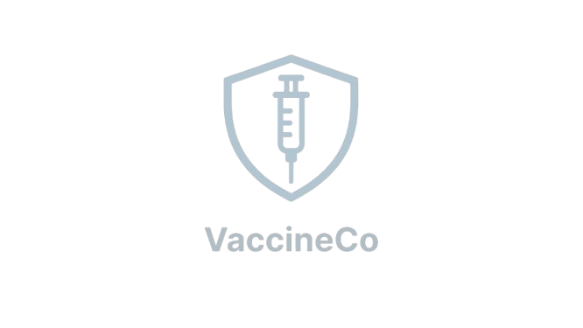





Executive Summary
OBJECTIVE
How can VaccineCo achieve upstream capabilities towards drug substance manufacturing and R&D capabilities while substanitally contributing to Africa’s Vision 2040 while navagating operational and financial challenges
Africa imports 99% of its vaccine supply despite consuming nearly 1/4th of the world’s vaccines (high exposure to price shocks and export bans). Most AVMs are limited to low-margin fill-finish operations, with only ~240 M doses projected locally against a 1.4 B-dose demand by 2030. Without stable long-term contracts and upstream capabilities, facilities risk sitting idle, undermining the AU’s 2040 self-reliance goal.
SITUATION
D - DEMAND
O - OPERATION
SE - SUPPLY & EXPANSION
STRATEGY
Secure long-term Contracts for demand stability
Contract Manufacturing through technology transfers and process development
  Build NOVAA hub, the Centre of Excellence
  Partner with local & Global R&D Institutes
  Launch SEZ Zones
SHORT TERM
LONG TERM
PLAN OF ACTION
  Partner with Biotech Suppliers in Measles & BCG Vaccine
  Sustainable ecosystem for open source antigen blueprints, green manufacturing & solar cold chains, & launch the Vaccine Academy
  Continue with Fill-Finish Capabilities
  R&D on existing endemic diseases through strategic partnerships with R&D Institutes
  Secure APA’s for long-term contracts via UNICEF, GAVI, AVAT
  VaccineCo’s current market share, by revenue increases from ~3% to 9% by 2040
IMPACT
  Projected revenue increase to $418Mn by 2040 (29.4% CAGR)
  Contract Manufacturing model to increasing production to 145Mn vaccines annually
  Through Malaria R&D in 2033, VaccineCo contributes to GDP effectively saving $85 of economic cost per dose

Slide 3
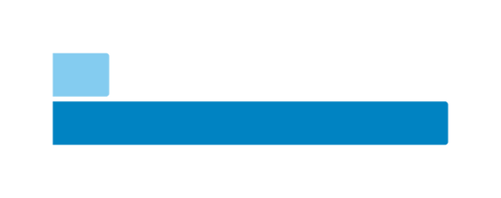






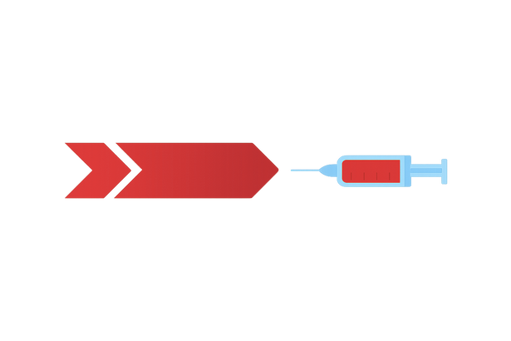

African Market Analysis: Heavy import reliance signalling urgency to expand upstream
VaccineCo needs to address upstream manufacturing capabilities to improve shrinking margins & fulfill Africa’s vaccine supply gap
African Market Dynamics
South African Market
VaccineCo
Africa’s Vaccine Gap by 2030
Capability gap
The market is flooded with fill and finish players due to limited upstream capabilities
Market Dynamics
A price-based government tender system puts heavily reliant local players at a disadvantage to global players
Macro constraints
High fiscal debt, along with fragmented cold chains, threatens production/distribution. This is accelerated with high unemployment and poverty
Fill & Finish manufacturer with a Mission to be a self-reliant contributor to Vision 2040
240 M
Projected Supply (AVMs)*
1.4 B
Projected Vaccine Demand
Incorporation in 2006
Consortium b/w PE firms & the SA government
Focus
Primarily in immunization vaccines with upstream integration as the primary end goal
Margins Collapse
EBITDA margins collapsed (from 28% to 6%) due to reliance on global suppliers & local currency depreciation
Revenue Stream
Government-based, making demand unpredictable & revenues concentrated, resulting in upstream aspirations highly uncertian
*Doses primarily for children through UNICEF
Funding Shift Post-Pandemic
The decline in COVID correlated with lower government and donor contributions, signalling sustainable funding
Fragile Supply Chains
Heavy reliance on cheaper external suppliers, widening demand and supply gap
Enablers for scale
“Buy African” policies, with a focus on value-based local procurement
Market Overview & Goals
Recommendations
Phase 1: Strategy
Phase 2: Strategy
Funding & Timeline

Slide 4




4 strategic priorities define VaccineCo’s roadmap to market leadership
VaccineCo must create a replicable model for drug substance manufacturing in short-term and include R&D in long-term
Strategic Priority Areas
VaccineCo’s Goals
Current Situation
Why is it critical?
Short Term
(0–5 years)
Heavy reliance on contract-driven and price-dependent government tenders with skewed winning results, hurting self-reliant efforts
  Upstream facilities need a guaranteed off-take, without costly financing
  Net margin collapse from 28% to 6% indicates risk-stranded assets
Demand
Certainty
Build in-house drug substance manufacturing capacity for at least two vaccines while continuing fill-finish for current products, creating a replicable model for expansion across vaccines and legacy diseases
  Drug-substance manufacturing needs advanced science, skilled talent, and short regulatory cycles
  Tech Transfers without exclusivity leave VaccineCo dependent on low-margin contract work
Long Term
(5+ years)
Only fill-finish production capabilities; lack of know how in API production & R&D capabilities
Operational Capability
Transition from a CMO to a CDMO and invest in R&D to address existing and emerging endemic diseases, establishing VaccineCo as Africa’s nexus for vaccine innovation
Reliance on imported raw materials, fragmented cold chains, and unreliable power supply
High infrastructure risks, power outages, and cold chain gaps risk stable contracts and company credibility
Supply Chain Security
STRATEGIC PRIORITIES
Ecosystem Weakness
Lack of biotech hubs, limited R&D investment, and human capital leave AU susceptible to unfavourable macro factors
Fill-finish model position VaccineCo as a volume and not a value leader
Build upstream capacity capturing 60-70% of value
Lower import dependency (~99%)
AU 2040 goal & health sovereignty (local R&D)
Market Overview & Goals
Recommendations
Phase 1: Strategy
Phase 2: Strategy
Funding & Timeline

Slide 5


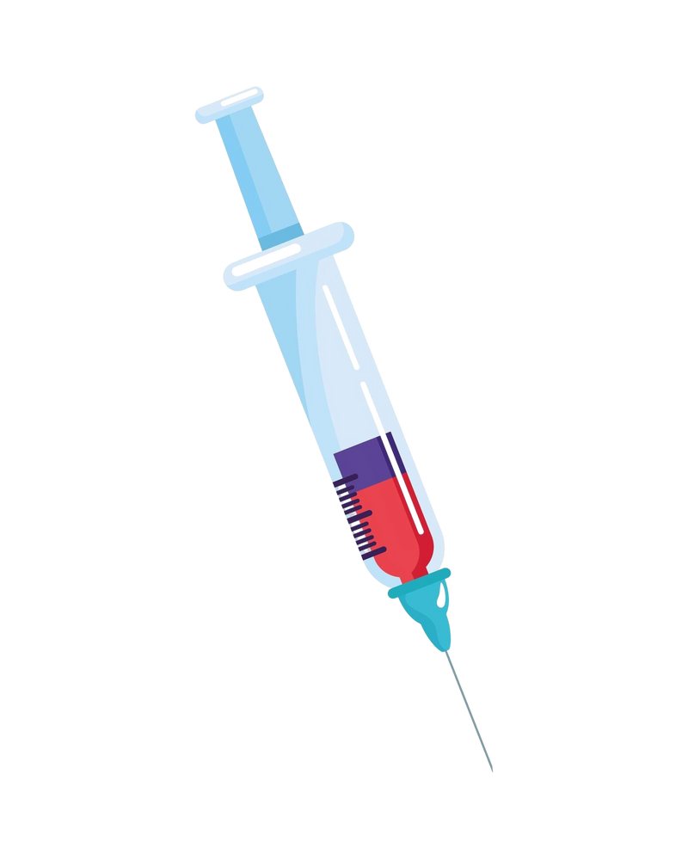




Our Proposal: The DOSE Framework for vaccine excellence
The DOSE strategy focuses on demand procurement, operations set-up, R&D initiatives and expansion towards a vaccine ecosystem
Demand
Operations
  Guarantee Demand: Advance purchase agreements & long-term agreements with Gavi, UNICEF, AVAT
  Multi-year contracts: Act as collateral, reassuring DFIs, donors & investors to release financing
  Aggregate Markets: AVAT & pooled procurement consolidate fragmented demand
  Contract Manufacturing: Partnering with Global Biotech players to accelerate antigen capability
  Tech Transfer: Access to embeded tacit knowledge
  Regulatory approval: Faster with established credibility
Supply
Expansion
  Global & Local Collaborations: Agreements with Global and African R&D institutes for antigen & preclinical development
  Milestone-linked Funding: Payments tied to validated deliverables ensuring continuity and exclusivity
  Open Antigen Library: VaccineCo acts as enabler and orchestrator
  Africa Vaccine Academy & Mobile Labs: Builds a continent-wide workforce
  Nexus of Vaccine Acceleration (NOVAA): Create an ecosystem focused on creating sustainable impact in the vaccine industry
Market Overview & Goals
Recommendations
Phase 1: Strategy
Phase 2: Strategy
Funding & Timeline

Slide 6



Strategy D: Building a sustainable vaccine pipeline through guaranteed demand
Securing longer term contracts de-risks financing and unlocks stable funding for Africa’s vaccine self-reliance journey
Why long-term contracts?
Process to secure contracts
Demand Inconsistency
With UNICEF / Gavi
With AVAT
African manufacturers face demand volatility. Advance purchase agreements guarantee off-take volumes, reducing risk of inconsistent/collapsing demand
1
Apply for Supplier Qualification
1
Engage via Africa CDC / Afreximbank
Difficulty in Attracting Funding
2
2
Political & Institutional Partnerships
Funders (DFIs, donors, private investors) hesitate to back manufacturers without guaranteed revenue streams. Long-term purchase agreements act as collateral, providing revenue certainty
Bid in Tenders
3
Negotiate LTAs
3
Financial Backing / Guarantees
Advance Purchase Agreements
4
Lack of order estimates creates unpredictable demand. APAs allow manufacturers to move from a just-in-time/emergency-response model to a reliable partner
Scale Gradually
Regional Coordination & Pooling
Negotiation Levers
Fragmented national demand makes individual African markets small for viability. AVAT (continental pooled procurement) and UNICEF (global procurement) consolidate demand
Volume + Price
Trade-off
Make in Africa
Vaccine manufacturing in Africa faces a classic chicken-and-egg dilemma: unpredictable demand makes it too risky to produce in advance. But without visible local production, donors and investors hesitate to fund new capacity. The result is a self-reinforcing cycle of underinvestment and supply vulnerability.
Tech Transfer &
Regional Capacity
Partnerships with Donors/Govt
Market Overview & Goals
Recommendations
Phase 1: Strategy
Phase 2: Strategy
Funding & Timeline

Slide 7
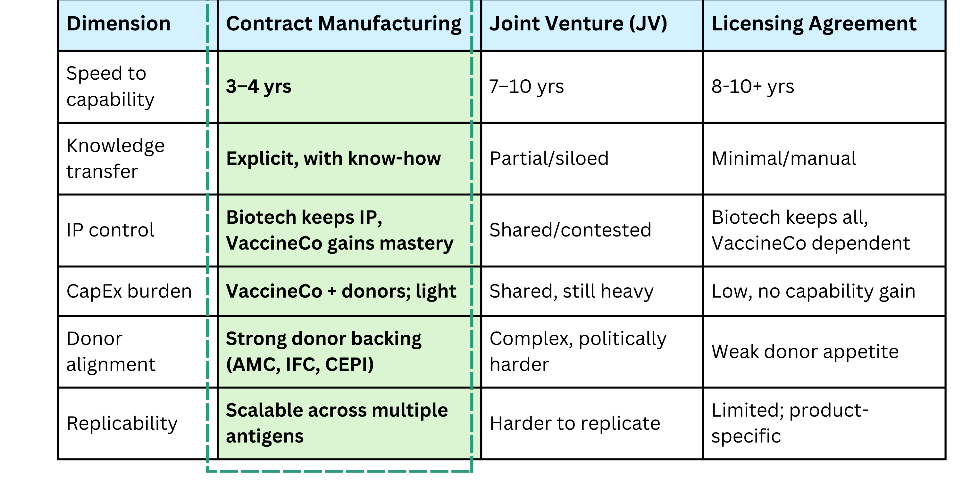




Strategy O: Addressing operations via Contract Manufacturing
Contract Manufacturing through Technology transfers and Process Development streamline long term vision by leveraging current capabilities
Vaccine Capability Models: A Comparative Lens
Contract Manufacturing Model
Short Term
(0–5 years)
Long Term
(5+ years)
Biotech provides seed banks, dossiers & staff under oversight; VaccineCo earns per-dose fees, validates facilities & gains WHO PQ credibility.
VaccineCo internalizes skills; Biotech shifts to audits; local suppliers integrated. VaccineCo expands into new antigens achieving autonomy.
Short-term = capacity under Biotech’s guardrails; Long-term = autonomy through competence
Why Global Biotech Will Agree
  Government push local production; refusal risks market loss
  Low capex CM model secures African market while keeping IP
  Strengthens ESG profile, blocks rivals
How does Contract Manufacturing reduce import dependency
Local Production
Progressive
autonomy
Retention of
know-how
Regional Supply Chain Development
Why VaccineCo Will Agree
  Cuts upstream build time from 7–10 yrs to 3–4 yrs
  Gains tacit know-how, accelerates WHO PQ credibility
  Shifts from low-margin fill/finish to higher value drug substance
Risks & Mitigation
Regulatory Delays
Financial Strain
Commercial
Volatility
Over-Dependency
Market Overview & Goals
Recommendations
Phase 1: Strategy
Phase 2: Strategy
Funding & Timeline

Slide 8





Strategy S & E: Launch of NOVAA , a pioneering force in vaccine development
A trailblazing ecosystem redefining Africa’s role as a global powerhouse in vaccine development and manufacturing
NOVAA: NEXUS OF VACCINE ACCELERATION IN AFRICA
VaccineCo’s antigen library makes it Africa’s knowledge hub, while its Vaccine Academy builds continent-wide expertise. Operations via solar cold chains cut costs. Its SEZ location ensures efficient delivery of vaccines catering to both adults & children.
3 building blocks of NOVAA
Upstream Sovereignty & R&D Integration
  Secure antigen blueprints through global and African partnerships
  Use tech-transfer & data escrow to retain knowledge
  Position Africa as an innovation lab for emerging, existing endemic & local diseases
End-to-End Manufacturing Excellence
Workforce & Ecosystem Orchestration
  Localize drug substance via CM & tech transfer in 3–4 years
  Leverage existing and new SEZs for cost and regulatory advantages
  Adopt green manufacturing and solar cold chains to meet ESG goals to cut costs
  Launch Vaccine Academy & mobile labs to build a continent-wide talent pipeline
  Create an open antigen library, support AVMs, and drive AMC-backed demand stability
  Act as a bridge between governments, donors, and biotech companies to ensure a predictable supply
LONG-TERM IMPACT
Boosts local production, skilled jobs, GDP, and health system resilience
Improves life expectancy by cutting vaccine-preventable disease burden
Builds end-to-end drug production capacity within Africa
Market Overview & Goals
Recommendations
Phase 1: Strategy
Phase 2: Strategy
Funding & Timeline

Slide 9
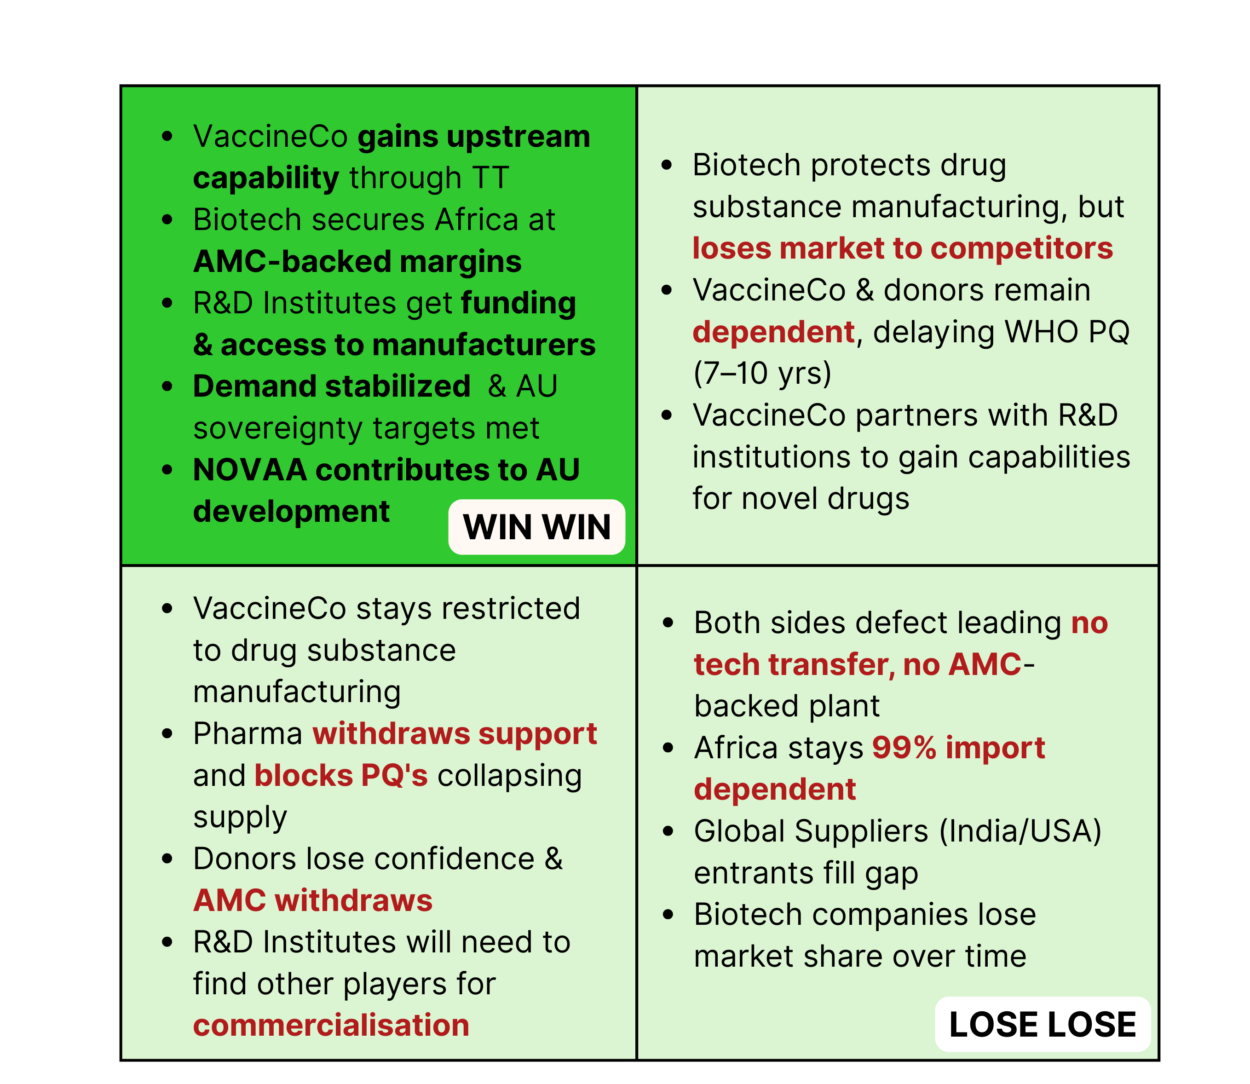




Strategy S & E: Real-world success stories that deliver tangible impact
Global precedents and game-theory insights that solidify Africa’s path to vaccine self-reliance
Replicable Strategies (Proof of Concept)
Potential Outcomes
Share capabilities
Don’t share capabilites
Tech Transfers: The GSK–Fiocruz partnership shows why phased tech transfers work. Over 8 years, the Hib vaccine transfer built local talent and facilities, ensuring true self-sufficiency, the model became a win-win and expanded to other vaccines
CDMO: India showcases a strong CDMO sector, with firms like Serum Institute and Biological E manufacturing vaccines for global pharma, including COVID-19. SII supplied doses to large economies like Canada and EU during COVID-19
VaccineCo + R&D Bloc Agree
R&D Initiatives: Vietnam’s $80M VNVC plant illustrates end-to-end manufacturing, partnering with Medsintez and Sanofi to localize advanced biologics and vaccines, ultimately aiming for full vaccine self-sufficiency
Localized Supply: Partnership with Poonglim during COVID-19 shows how govt. financing and a strategic tie-up with Samsung scaled syringe production 7-fold in 4 months, proving a rapid boost in self-sufficiency and supply security in health crises
VaccineCo + R&D Bloc Disagree
Market Overview & Goals
Recommendations
Phase 1: Strategy
Phase 2: Strategy
Funding & Timeline

Slide 10
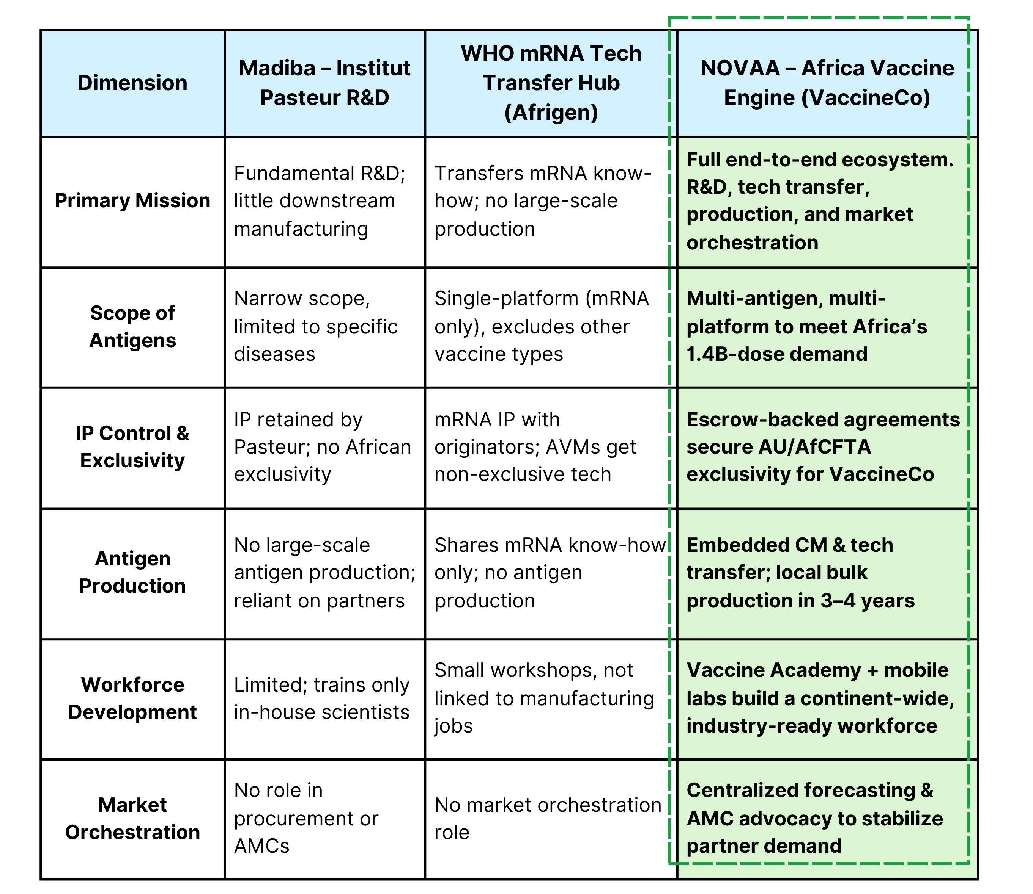
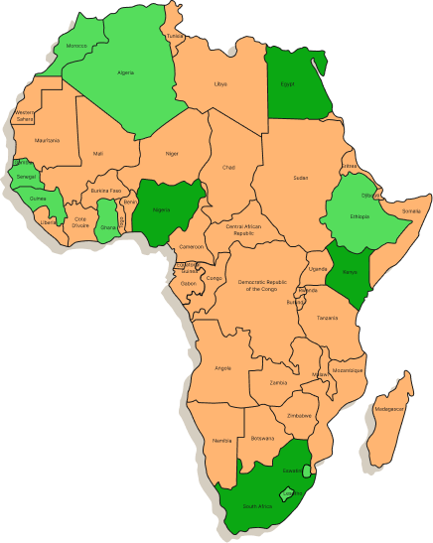



Strategy S & E: Anchoring NOVAA in South Africa, a gateway to vaccine sovereignty
South Africa provides the optimal base for NOVAA, with SEZs enabling swift expansion into Africa’s fastest-growing markets
Vaccine Capability Models: A Comparative Lens
Competitor Benchmarking
South Africa > Nigeria > Egypt > Kenya
Special Economic Zones
Cairo (Alexandria SEZ), Egypt
  Attracts biotechnology companies from around the world
  SEZ set in each region in a phased manner, starting with West Africa
  Fiscal relief with tax breaks
  Creates customs efficiency & cluster effect
Nairobi (Konza SEZ), Kenya
Strategic Impact
Lagos (Lekki SEZ),
Nigeria
Africa: Competitive force in global heath markets
NOVAA Base at
Cape Town, South Africa
Donors: Funds a self-sustaining ecosystem
Regulatory Strength
Biotechnology Partners: Market access, Protects IP, no CapEx
Infrastructure
Political Capital
SA, Launch of NOVAA
VaccineCo: Africa’s anchor and world’s bridge in vaccine
Market Access
SEZ Zones
Other Regions
Market Overview & Goals
Recommendations
Phase 1: Strategy
Phase 2: Strategy
Funding & Timeline

Slide 11
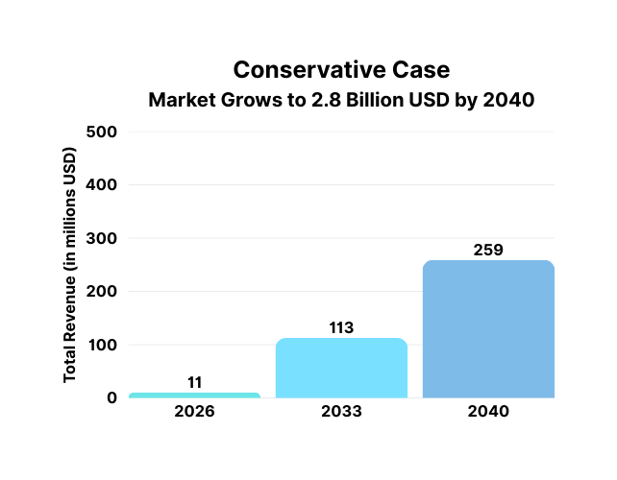
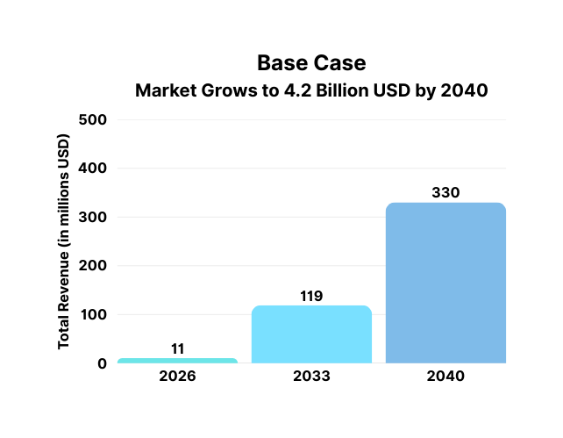
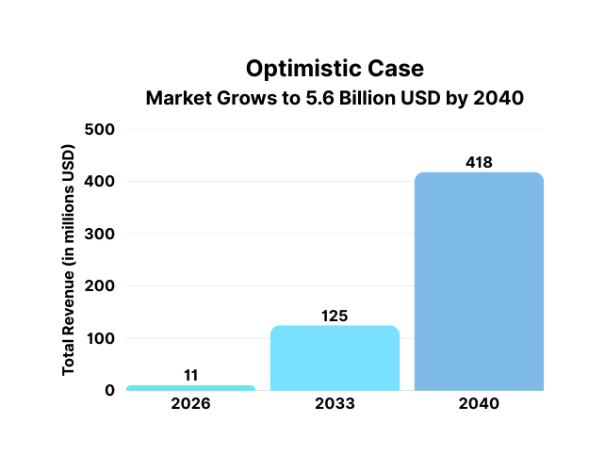
From Pipeline to Market Leadership: VaccineCo's Path to Vision 2040
A Strategic Roadmap for VaccineCo's Financial Growth and Global Impact from 2026 to 2040
Financial Projections (2026-2040)
29.6% CAGR
25.3% CAGR
27.5% CAGR
R&D Partnerships
Tech Transfers
Funding Sources
Total Cost
Who Funds It
Total Cost
Who Funds It
Short Term
0-5 Years
  12.5 M Local
  10 M Incremental Global
• Gov’t/ NRF/Universities
• Donors (BMGF/Wellcome)
• Company
  AVMA Milestone Payment (20M)
  BMGF/Wellcome (10M)
30 M
Long Term
5+ Years
  140 M Local
  28 M Incremental Global
• Gov’t
• Donors (BMGF/Wellcome)
• Dev Banks/IFC
• Company
  AVMA Milestone Payment (20M)
  IFC (15M)
  BMGF/Wellcome (30M)
  Company (15M)
80 M
Market Overview & Goals
Recommendations
Phase 1: Strategy
Phase 2: Strategy
Funding & Timeline

Slide 12



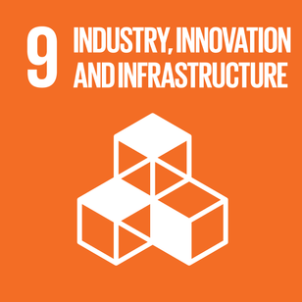
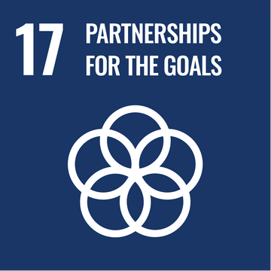
VaccineCo's model and funding sources drive UN sustainable development goals
A strategic imperative for long-term growth and impact, creating a virtuous cycle of public good and sustainable business growth
Roadmap to 2040
Production of drug substance of measles rubella (MR) vaccine by contract manufacturing (eg. Serum Institute of India) as VaccineCo is doing fill/finish for measles vaccine & it is a priority vaccine for AVMA
Replicate the strategy of the MR vaccine and start the production of BCG vaccine for tuberculosis because it has a similar live vaccine platform and 25% of global TB cases are in Africa
Launch the NOVAA facility, our nexus for vaccine development. Built on 3 foundational pillars of: Upstream Sovereignty & R&D Integration, End-to-End Manufacturing & Workforce Orchestration
Start the production of the malaria vaccine due to its large impact on Africa backed by the research through NOVAA and tech transfers and process development through contract manufacturing
We capture 7%-9% of the African vaccine market and achieve goal of being an end to end manufacturer and contribute significantly to Vision 2040
2026
2027
2030
2033
2040
Strategic alignment with UN Sustainable Development Goals
VaccineCo safeguards all ages through disease-preventing vaccines
VaccineCo strengthens infra through NOVAA, a Centre of Excellence driving vaccine R&D
VaccineCo expands vaccine access through global & local R&D and manufacturing partnerships
Market Overview & Goals
Recommendations
Phase 1: Strategy
Phase 2: Strategy
Funding & Timeline

Slide 13
Appendix: Incremental Profit & Loss Statement for VaccineCo
GDP Impact per dose Calculation
Hedging Method for currency fluctuations
Doses per Person | Total Doses = Population × Doses | Calculation (127B ÷ Total Doses) | Saving per Dose
1 dose | 1.5B × 1 = 1.5B | 127B / 1.5 B | $84.7
2 doses | 1.5B × 2 = 3.0B | 127B / 3.0 B | $42.3
3 doses | 1.5B × 3 = 4.5B | 127B / 4.5 B | $28.2
4 doses | 1.5B × 4 = 6.0B | 127B / 6.0 B | $21.2
Hedging Method | Description | When to Use | Benefits | Considerations
Forward Contracts | Lock in exchange rate today for future payment | Predictable contract payments | Budget certainty, no upfront cost | Obligated to transact at agreed rate
Currency Options | Right (not obligation) to exchange at set rate | Uncertain timing or amount of payments | Flexibility with downside protection | Requires premium payment
Natural Hedging | Match currency inflows and outflows | When revenues and costs align in same currency | Reduces net exposure, cost-effective | Limited by operational flexibility
Invoice in USD | Negotiate contracts to use USD | To transfer currency risk to partners | Simplifies exposure management | Depends on partners' agreement
Partial Hedging | Hedge only part of exposure (e.g., 50-70%) | To balance risk and potential gains | Limits losses, retains some upside | May still have some currency risk
Regular Monitoring | Track exchange rates and adjust hedges | Ongoing | Keeps strategy aligned with market | Requires active management
Industry growth rate calculation
Scenario | Growth rate | Calculation | Market size by 2040 as in case
Conservative case | 5.60% | ((2.8/1.3)^(1/14))-1 | 2.8 Billion
Base Case | 8.30% | ((4.2/1.3)^(1/14))-1 | 4.2 Billion
Optimistic case | 11% | ((5.6/1.3)^(1/14))-1 | 5.6 Billion
Note: Additive growth of 5.3% from year 8 due to malaria vaccine
source: https://www.credenceresearch.com/report/malaria-vaccines-market

Slide 14
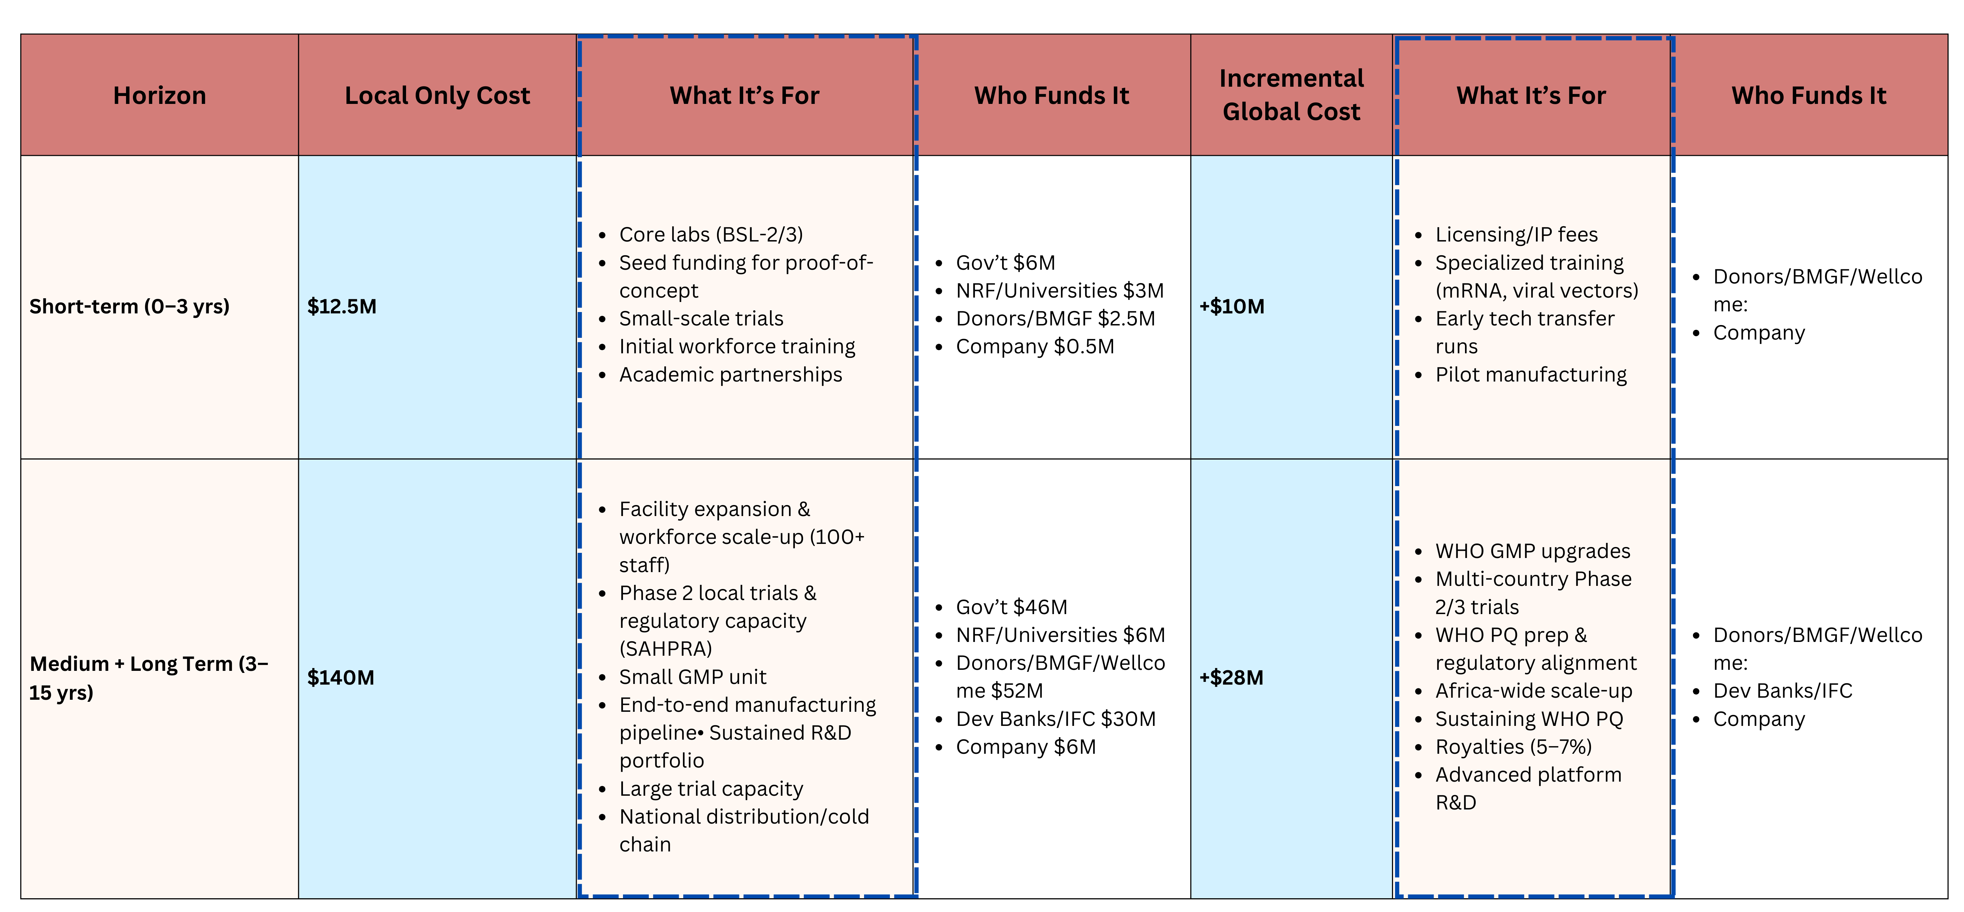
Appendix: R&D Partnership Cost & Funding Table
Note:
  Total Cost of MADIBA Facility: 222 Million
  Total Cost of our Facility: 262-300 Million, depending on global partnerships
  Source: https://www.ifc.org/en/pressroom/2022/ifc-and-institut-pasteur-de-dakar-deepen-their-partnership-to-build-covid-19-vaccine-manufacturing-facility

Slide 15
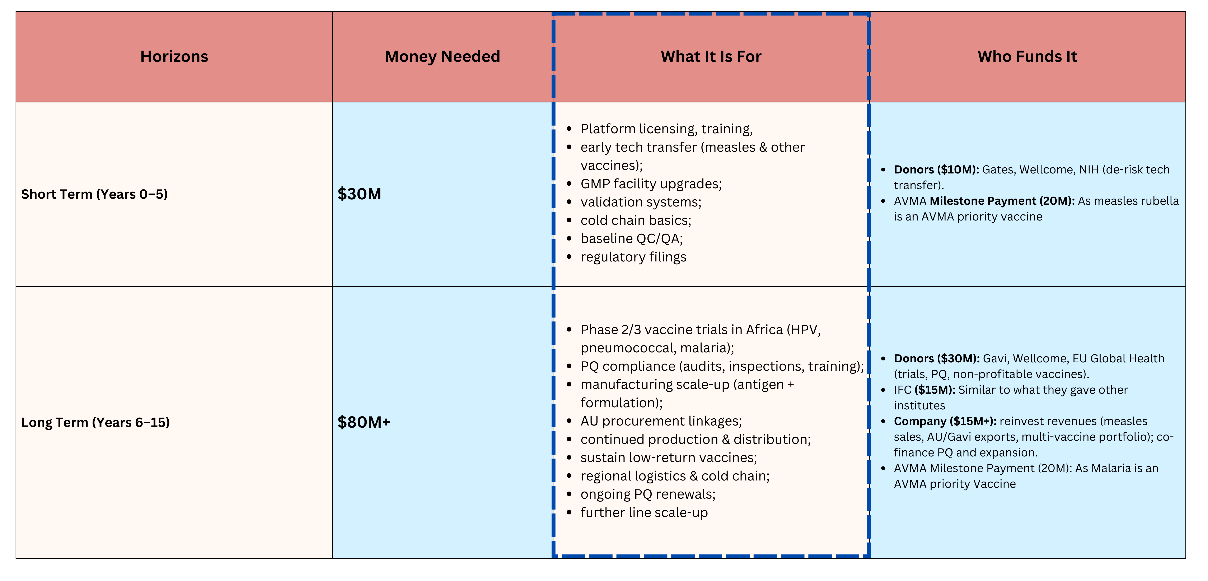
Appendix: Funding for tech transfer

Slide 16
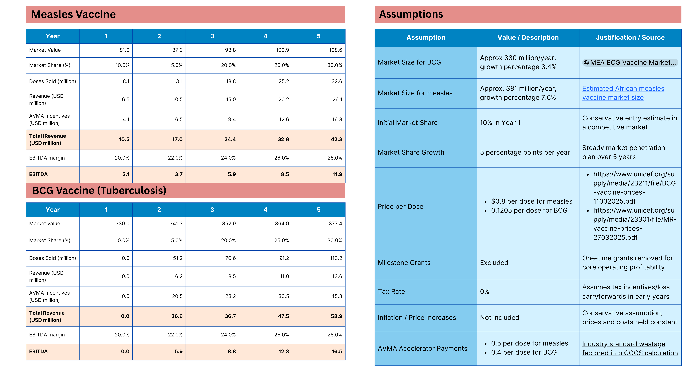
Appendix: Incremental Profit & Loss Statement for Measles & BCG

Slide 17
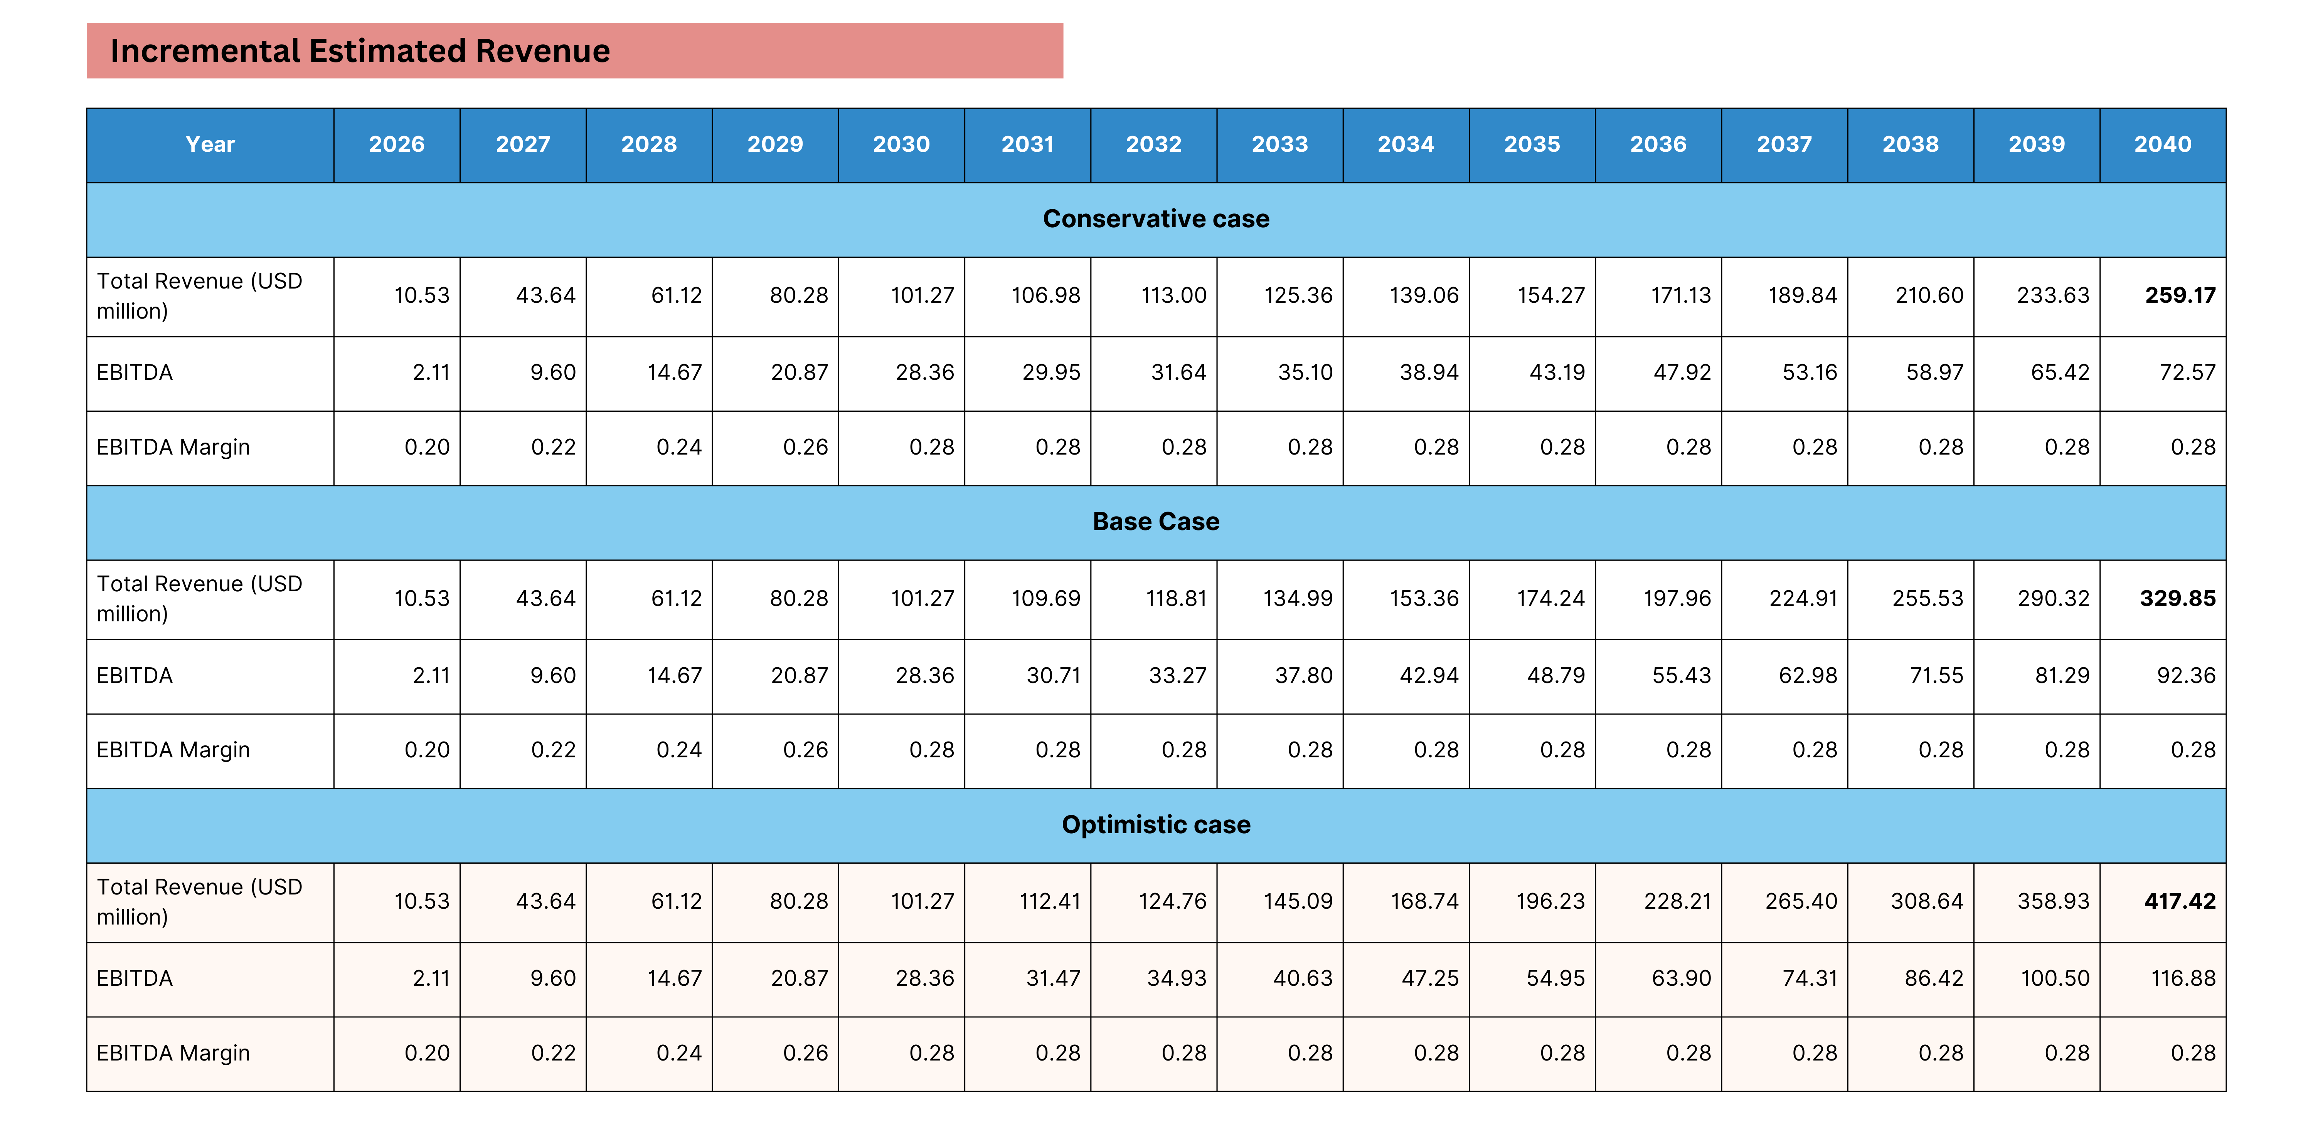
Appendix: Incremental Profit & Loss Statement for VaccineCo

